Slide 1

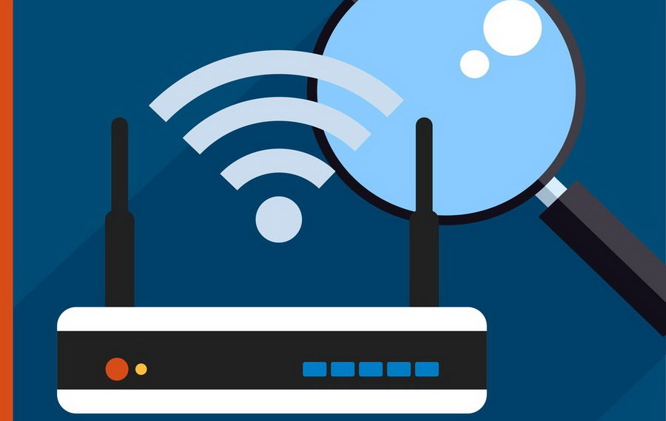
WLAN troubleshooting
Jorael Jamison – CSIA 330 Wireless security

Slide 2
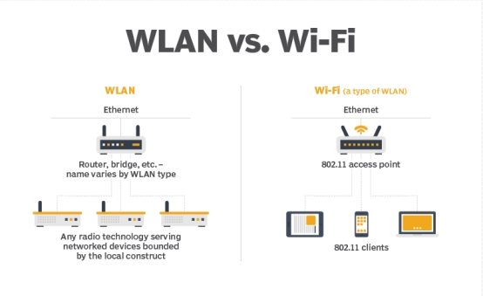

Understanding terms
What does WLAN and Wi-Fi stand for?
and
What are the differences, if any between WLAN and Wi-Fi?

Slide 3

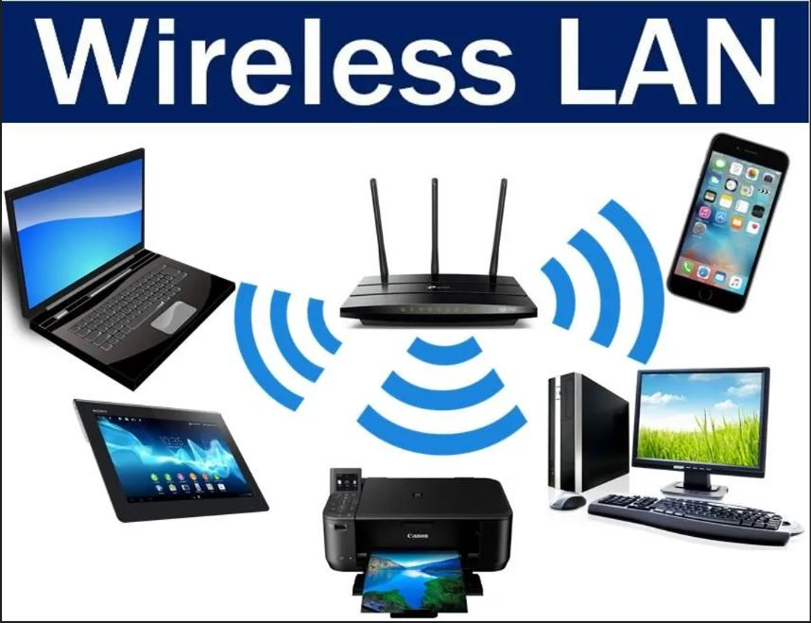
Understanding terms
Wi-Fi is a registered trademark of the Wi-Fi Alliance, a non-profit organization in charge of certifying products meet the IEEE 802.11 wireless protocol standard.
Wi-Fi is a family of network protocols based on the IEEE 802.11 standard and a specific type of WLAN.
Wi-Fi stands for… nothing!
WLAN stands for wireless local area network.
WLAN uses radio technology to connect two or more devices using wireless communications to form a LAN.

Slide 4

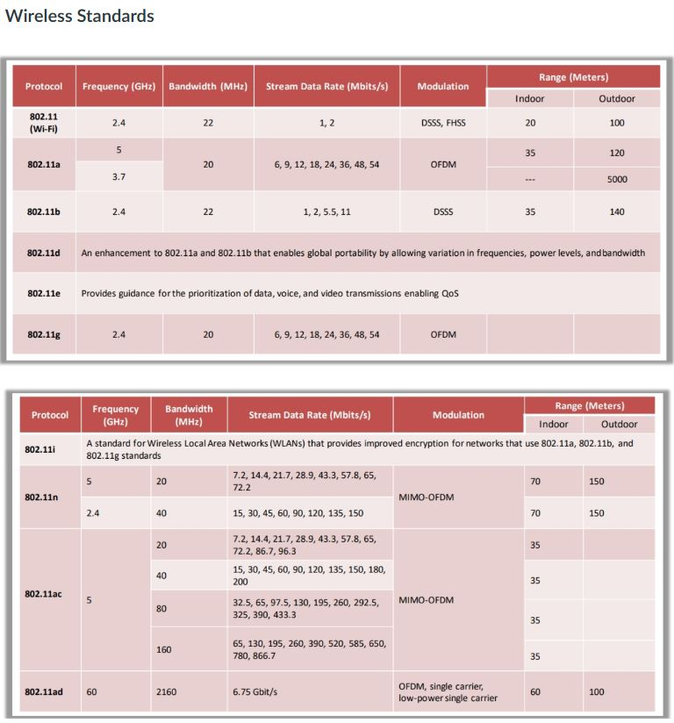
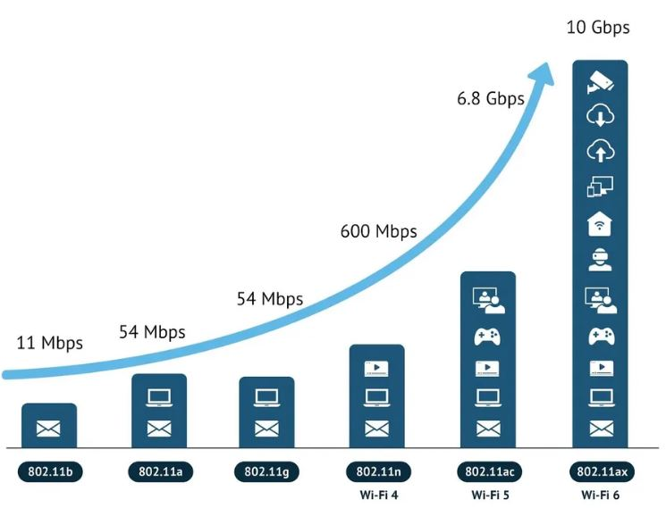
Wi-Fi 6 (802.11ax)
Greater capacity and improved security.
Multi-gigabit data rates.
Better power efficiency and high performance even when congested.
Backward compatibility with 802.11ac and 802.11n.
Works for both 2.4 GHz and 5 GHz frequency bands.

Slide 5
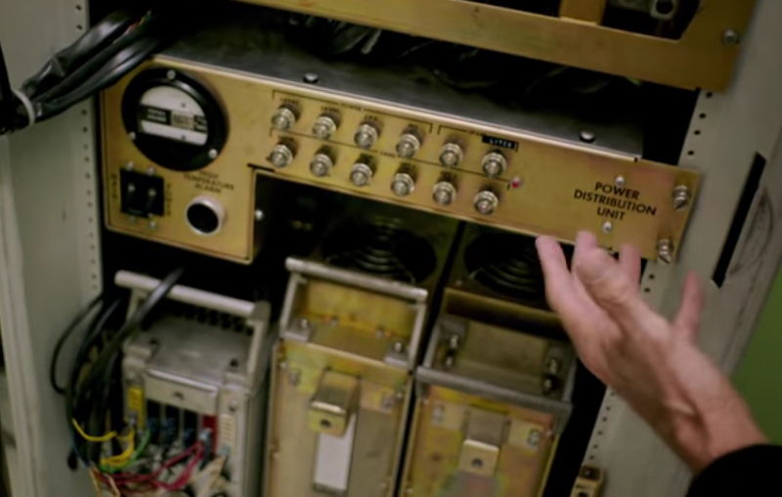
wlan troubleshooting – Outdated equipment
Less secure
Lower speeds
Lack of user support
Lack of firmware updates
Limited device compatibility
Modern 802.11 radios use newer CCMP encryption, older equipment may be unsupported.

Slide 6
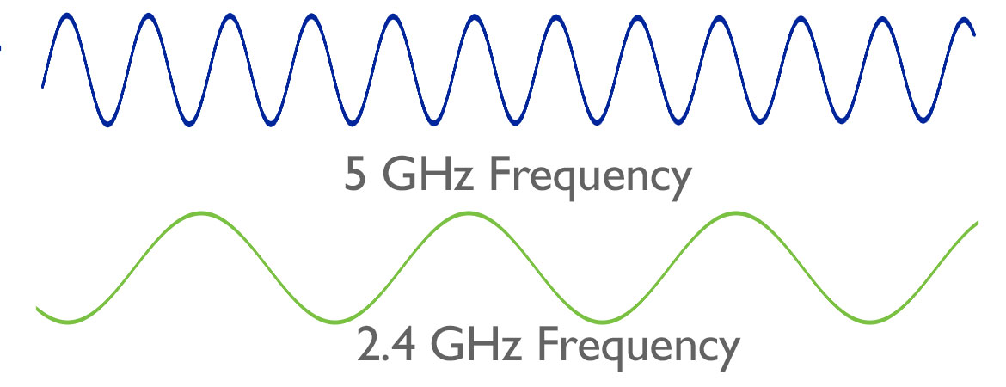
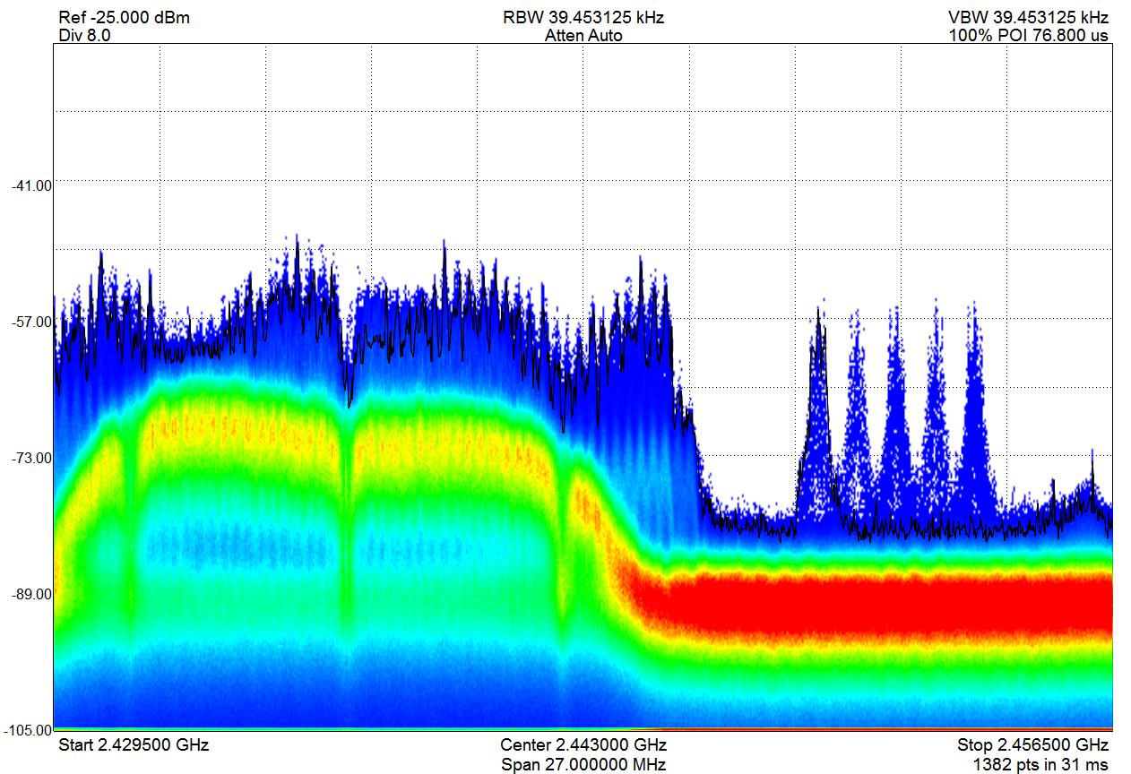
RF Interference
Wi-Fi signals communicate via electromagnetic radio frequencies (RF).
RF is the most common external cause of WLAN problems at OSI Layer 1.
Numerous devices run on the RF spectrum and may cause interference preventing 802.11 radio from being transmitted if the energy detect threshold is exceeded causing DoS, corrupted frames and excessive re-transmissions.
Devices includes cellular phones, microwaves, and video cameras. If this occurs, you can change the Wi-Fi channel to fix the interference.
The 2.4 GHz Frequency is extremely crowded vs the 5 GHz space and accounts for the most interfering devices.
Types of RF Interference -
Narrowband Interference:
Smaller and finite frequency, will not cause DoS for an entire band, like 2.4 GHz.
Very high amplitude and will disrupt communications in the space being transmitted.
Can result in corrupted frames and re-transmissions.
Only can be eliminated by locating source with a spectrum analyzer and remove interfering device or determine the affected channels and update the channel reuse plan.
Wideband Interference:
Ability to disrupt the communications of an entire frequency band.
Wideband jammers can create a complete DoS for the 2.4 GHz spectrum.
Only can be eliminated by locating and removing the interfering device using a spectrum analyzer.
All-Band Interference:
Associated with frequency-hopping (FHSS) communications that can disrupt the 802.11 communications at 2.4 GHz.
FHSS will not typically cause DoS.
802.11 FHSS technology is dated 20 years old and rarely used in the enterprise.

Slide 7
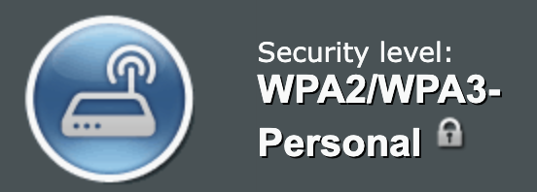
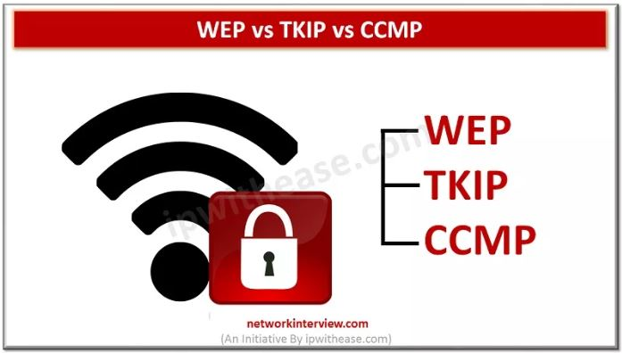
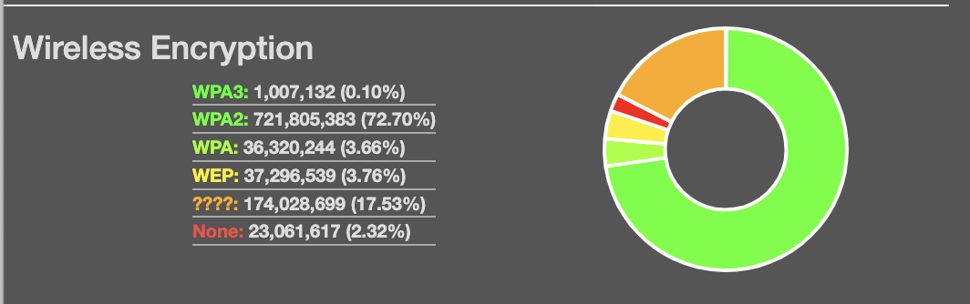
Wireless Protocols & Encryption methods
WEP: Wired Equivalent Privacy – Oldest and Least Secure method, can be easily cracked.
TKIP: Temporal Key Integrity Protocol – Older protocol, used with WPA wireless networks. Less secure.
CCMP: Counter Mode CBC-Mac Protocol. Replaced the TKIP encryption mechanism and is the standard for WPA2 & WPA3 wireless networks. CCMP Uses the very secure AES-128 Encryption.
WPA3:
WPA3 Most secure method, but far less common. Suggested setting utilizes both >

Slide 8


Five Tenets of wlan troubleshooting
Implement troubleshooting best practices.
Troubleshoot the OSI model.
Most problems are client side.
Proper WLAN design/planning is important.
The WLAN will always get the blame.

Slide 9

Tenet #1 Troubleshooting best practices – Ask Questions and collect information.
When is the problem happening? At what time did the problem occur? Does this problem happen during a very specific time period?
Where is the problem happening? Is the problem widespread, or does it exist only in one physical area? Is the problem occurring on a single floor or in the entire building? Does the problem affect just one access point or a group of access points?
Does the problem affect one client or numerous clients?
Does the problem reoccur or did it just happen once?
Did you make any changes recently?
Remember: Most connectivity issues are client side.
Best practice is to ensure any network configuration changes that take place are planned and scheduled.
WLAN infrastructure security audit logs will always leave a paper trail of which administrator made which changes at any specific time. Also great in determining time and frequency problems occur.

Slide 10
Solving the problem best practices
Identify the issues.
Ask questions and collect information to determine if a problem actually exists.
Re-create the problem.
Duplication allows you to collect more information to diagnose the problem.
Locate and isolate the cause.
Solve the problem.
Test to verify the problem is solved.
Document the problem and the solution.
Best Practice: Document all problems, diagnostics, and resolutions.
Provide feedback.

Slide 11
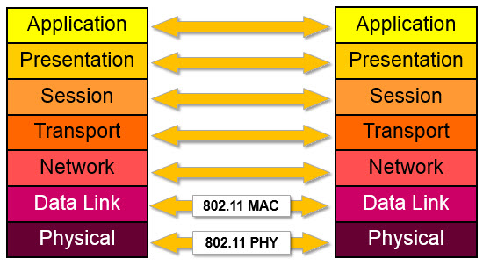
Tenet #2 Troubleshooting the osi model Tenet #5 The wlan will always get the blame
Use a bottom-up approach when investigating the problem.
802.11 wireless networks and 802.3 wired ethernet networks all reside and operate within Layers 1 and 2.
Most common connectivity issues can be solved within these two layers.
If Layer 1 and 2 are ruled out than the problem is not Wi-Fi related.
Tenet #5 (WLAN will always get the blame):
Wi-Fi will be blamed for problems that have nothing to do with the Wi-Fi network, which is why troubleshooting up the OSI model is important to eliminate Wi-Fi as the culprit.
Wi-Fi issues only exist within Layers 1 and 2.
Clients cannot comprehend issues outside of being able to connect to the Wi-Fi. Be patient.

Slide 12
Troubleshooting layer 1
Non-powered access points.
Root cause of connectivity or performance issues.
Disruption of RF Signal and interference
Cause of performance and coverage issues of your WLAN.
Inadequate WLAN coverage, capacity, and performance.
Result of poor WLAN design.
Client driver issues and misconfigured devices.

Slide 13
Troubleshooting layer 2
Excessive retransmissions:
Increase airtime consumption causing traffic to be delayed and inconsistent.
Retransmissions occur due to 802.11 frames not being received due to a collision or the frame being corrupted.
RF Interference from non-802.11 transmitters.
Be concerning to time-sensitive applications like VoIP.
Adjacent Channel Interference:
Overlapping frequency space due to improper channel reuse.

Slide 14
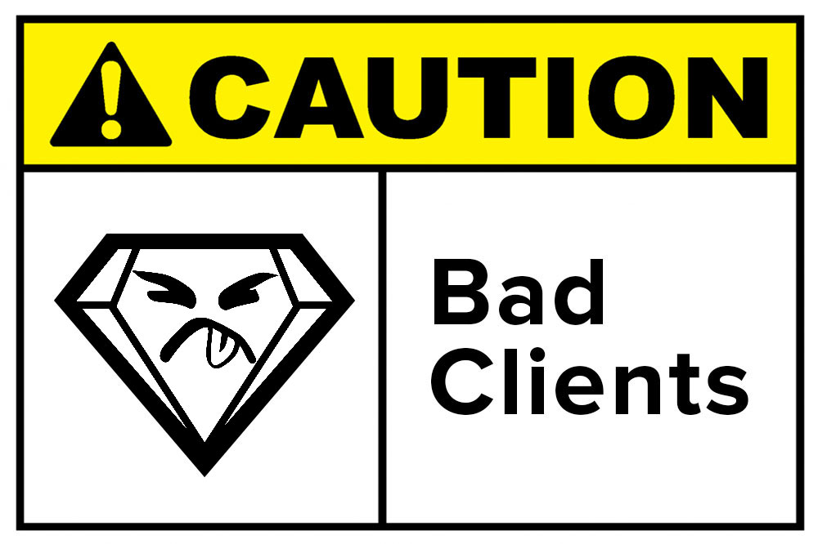
Tenet #3 – most problems are client-side
Helpful tips to troubleshooting client-side issues:
Disable and Re-enable the WLAN network adapter.
Firmware and Drivers are up to date.
Reconfigure the client configuration profile or connection parameters.

Slide 15
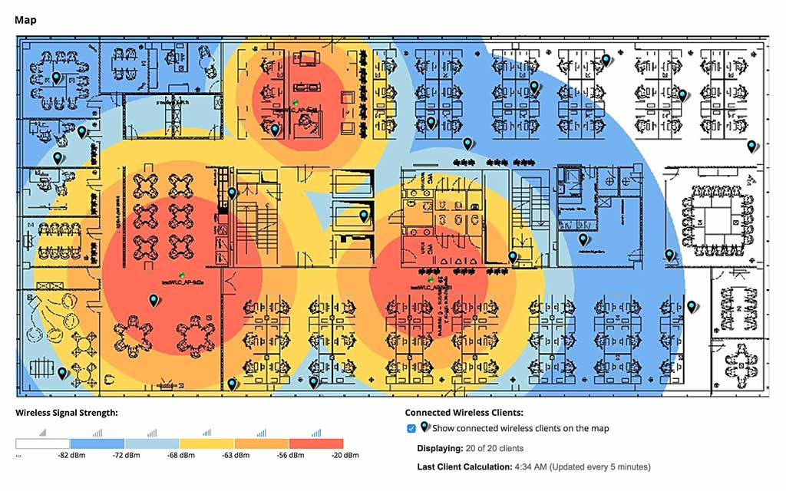
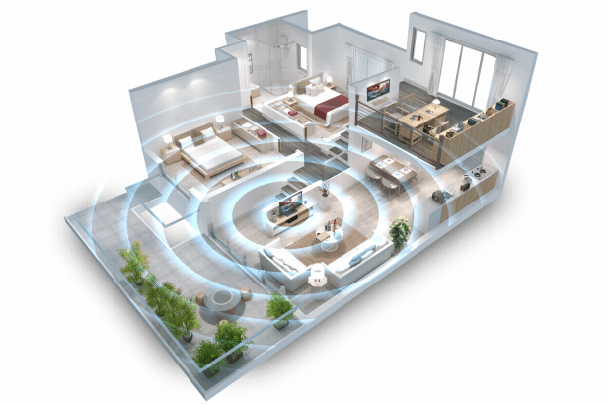
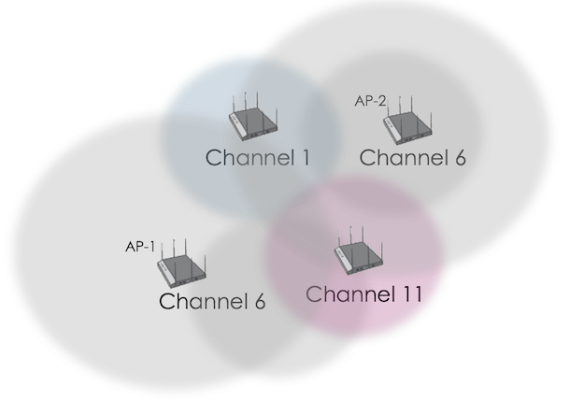
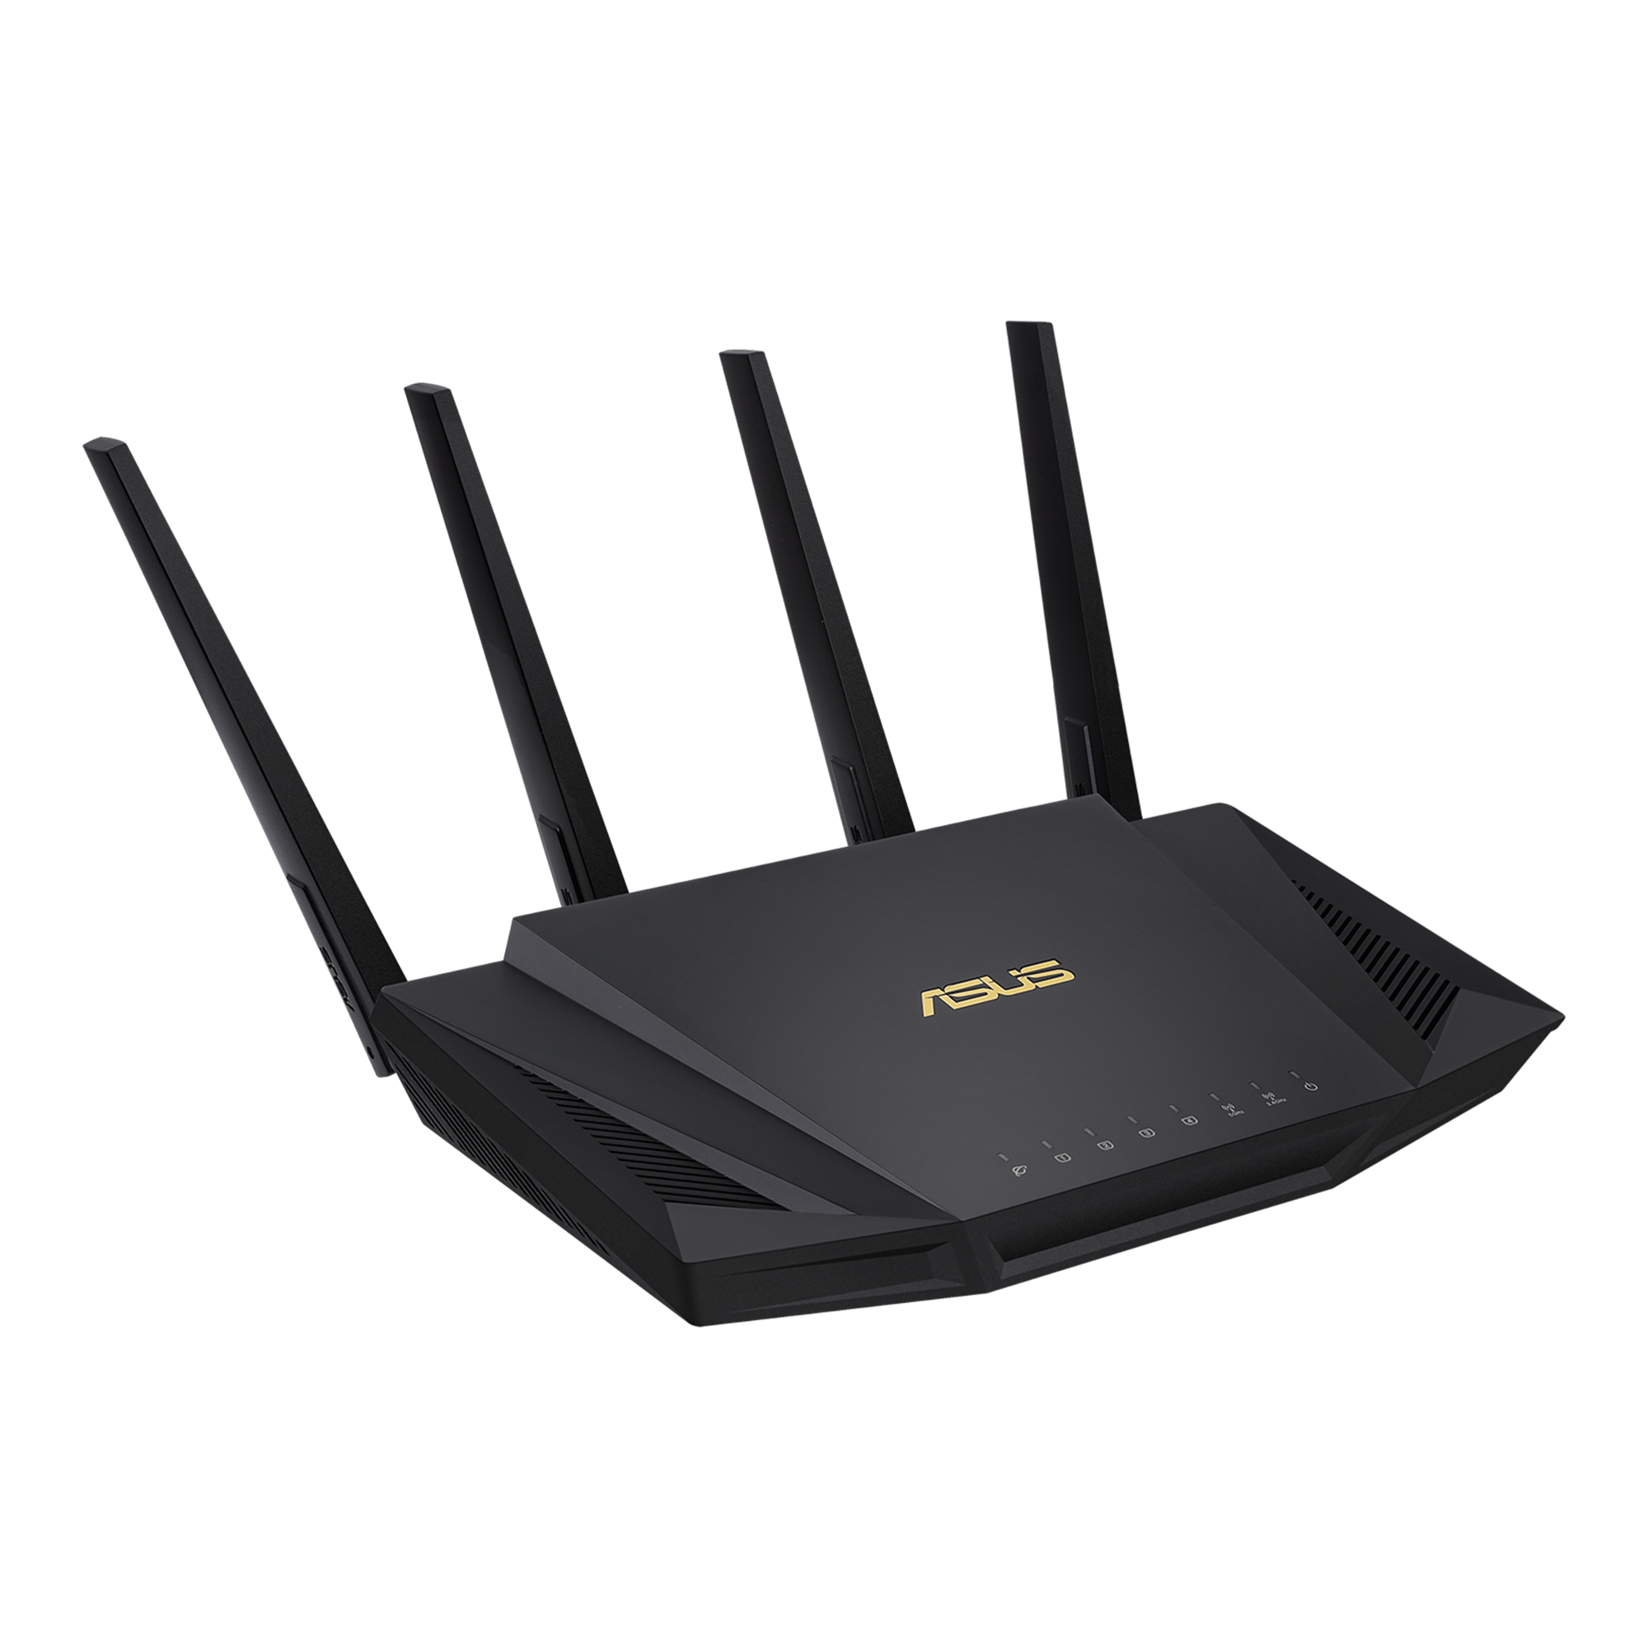
Tenet #4 proper wlan design 7 planning
Lack of site survey validation result in coverage holes and capacity issues.
Signals greater than -70dBm (closer to zero) the better for improved quality.
Spectrum Analysis determines whether interference exists.
Validation site surveys test predictive wireless designs before a network is deployed.
Implement proper security strategies for employee devices, BYOD, and guest Wi-Fi.
Mitigate co-channel interference (CCI).
Ensure transmission power of APs are not set to full power: Standard is one-fourth to one-third full power.

Slide 16

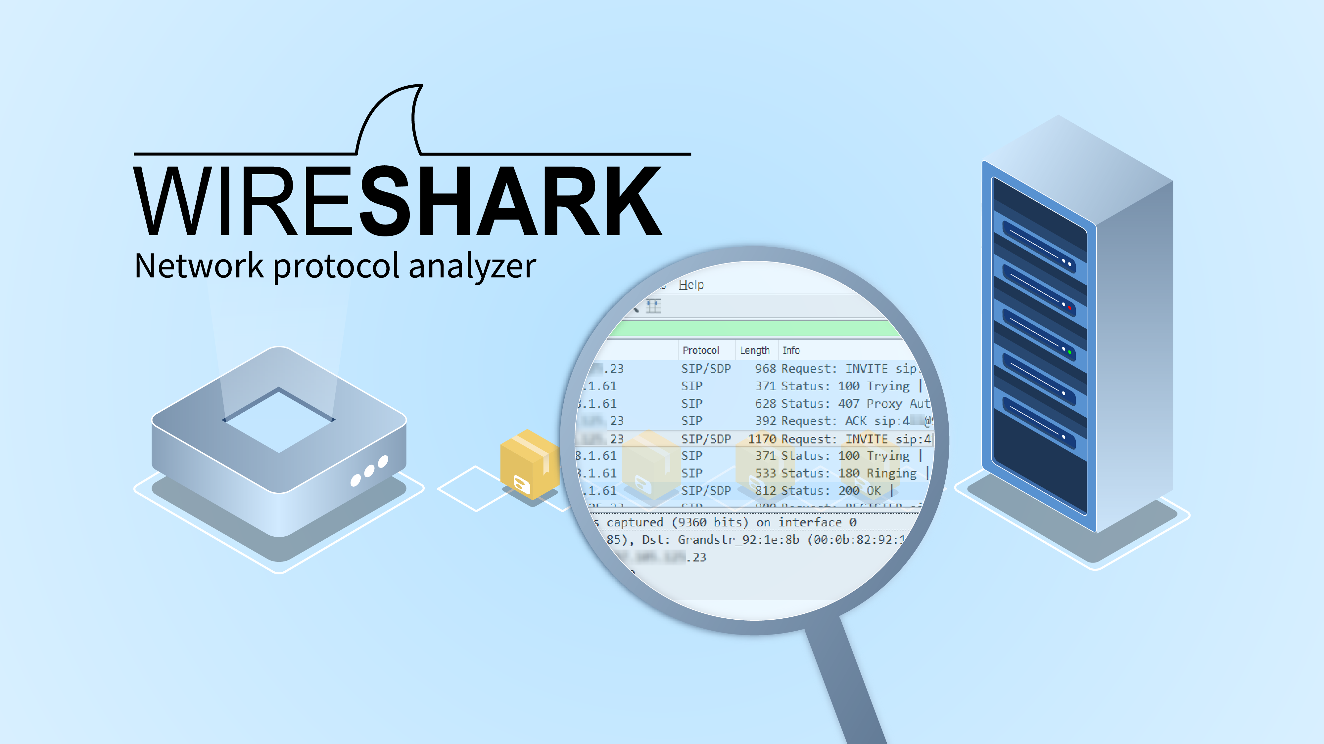

Troubleshooting and Diagnostic Tools
Spectrum Analyzer: Used to locate sources of RF interference. Most enterprises use 5 GHz band, which is less crowder and has much more space although 5 GHz RF interference does exist.
WiFi Analyzer: Useful tool providing wireless networks, signal strength, coverage, names, and security configuration. Aids in troubleshooting Wi-Fi related issues and in planning networks.
Examples: Solarwinds Network Performance Monitor, InSSIDer, NetSpot, TCPDump and Wireshark.
Protocol Analyzer: Measurement tool or device to capture and monitor the data over communication channels. Converts the data bits into a meaningful protocol sequence.

